Slide 1
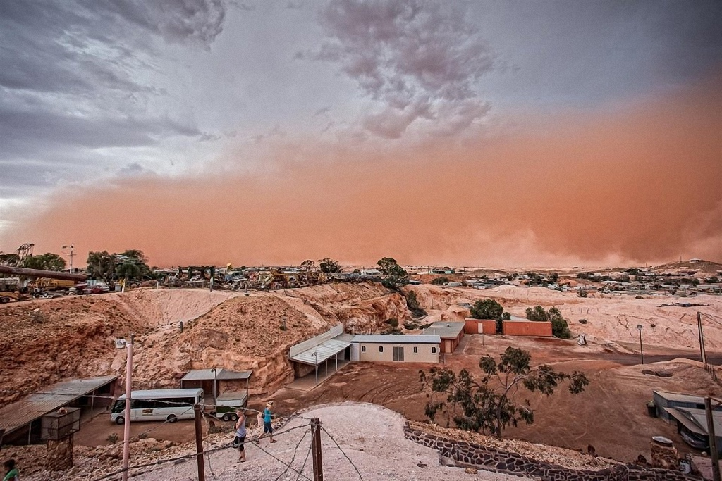
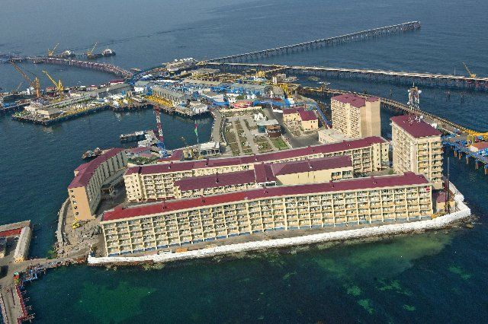
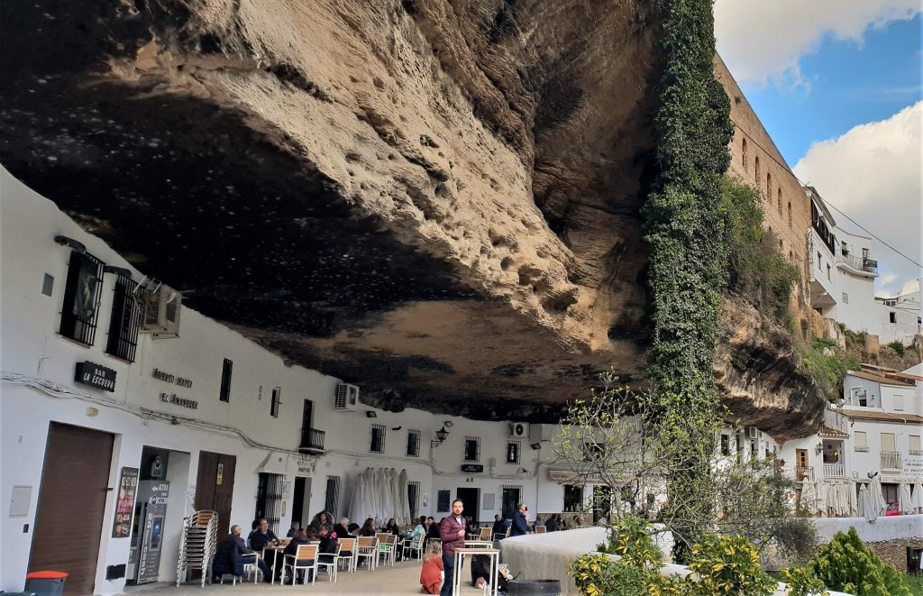
THE MOST UNUSUAL CITIES IN THE WORLD
Sergei Simko
Nikita Demidovich
Dina Zambalova

Slide 2
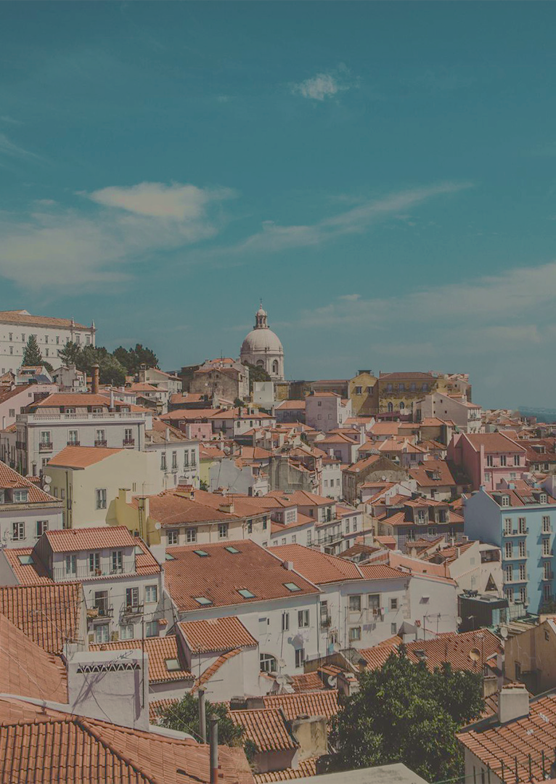
Intro
While most of the time we only hear about the most important cities, or those with the most breathtaking architecture, there are many quirky and bizarre cities hiding in spots you wouldn’t ever imagine all over the world.
2

Slide 3
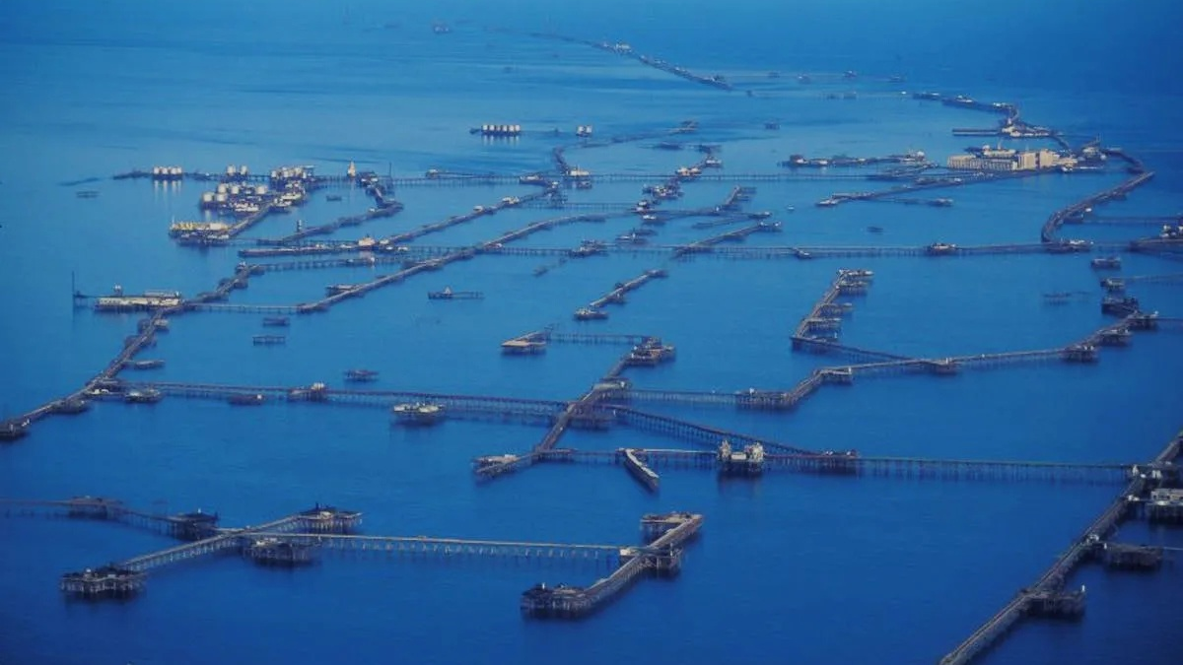
Neft Dashlari
3
3
3

Slide 4

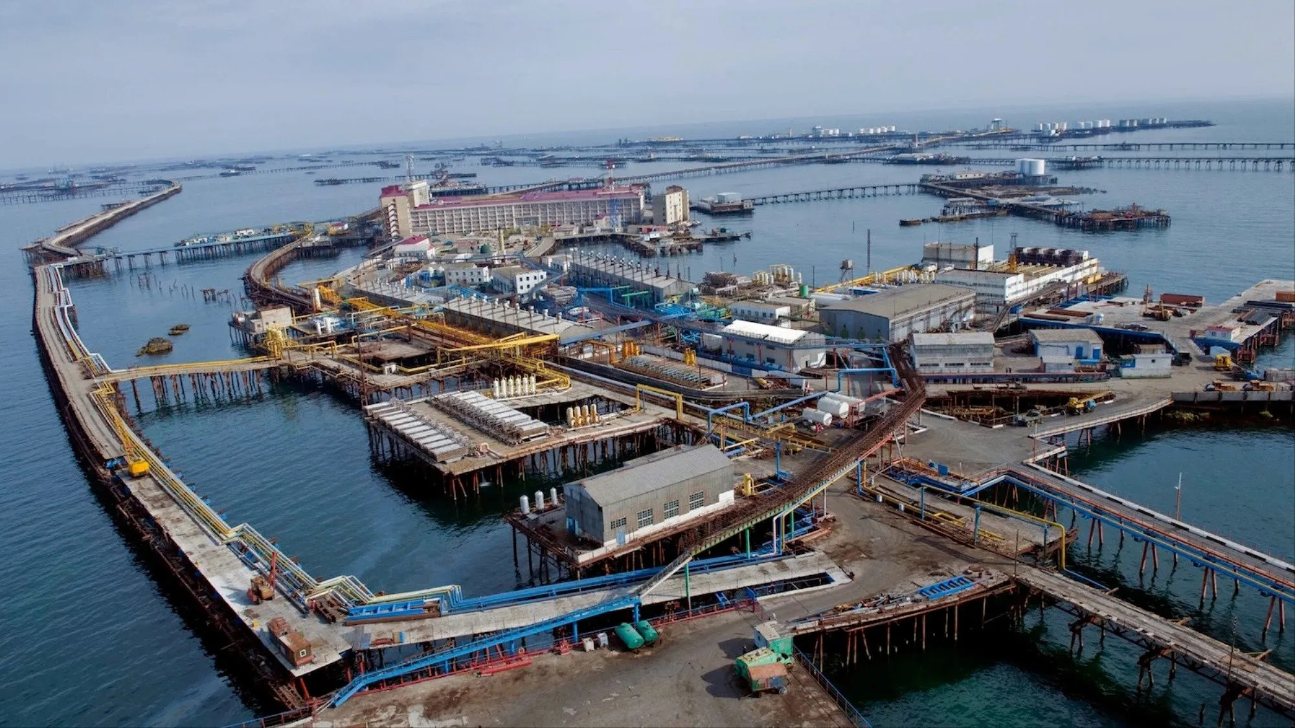
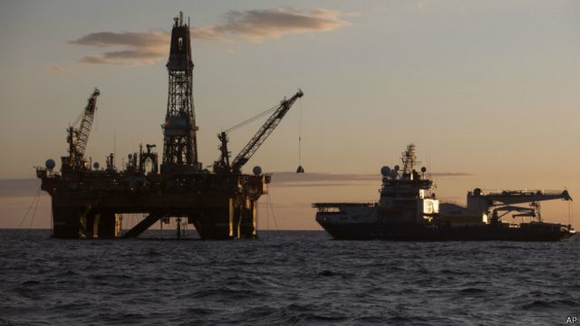
The city of Neft Dashlari is a gigantic floating city in the Caspian Sea that has acted as a huge oil operation for many decades. It was officially property of Azerbaijan and was built by the Soviet back at the height of their power.
4

Slide 5

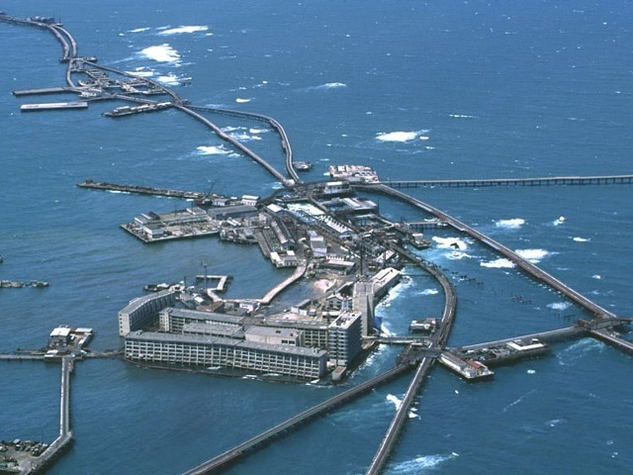
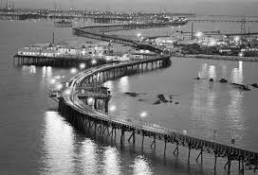
The city isn’t incredibly far from land, but it is the most massive city in the sea that has ever been built and was a testament to Soviet engineering at its most ambitious. It was built on the spot after the Russians discovered a lot of oil reserves in the area.
5

Slide 6
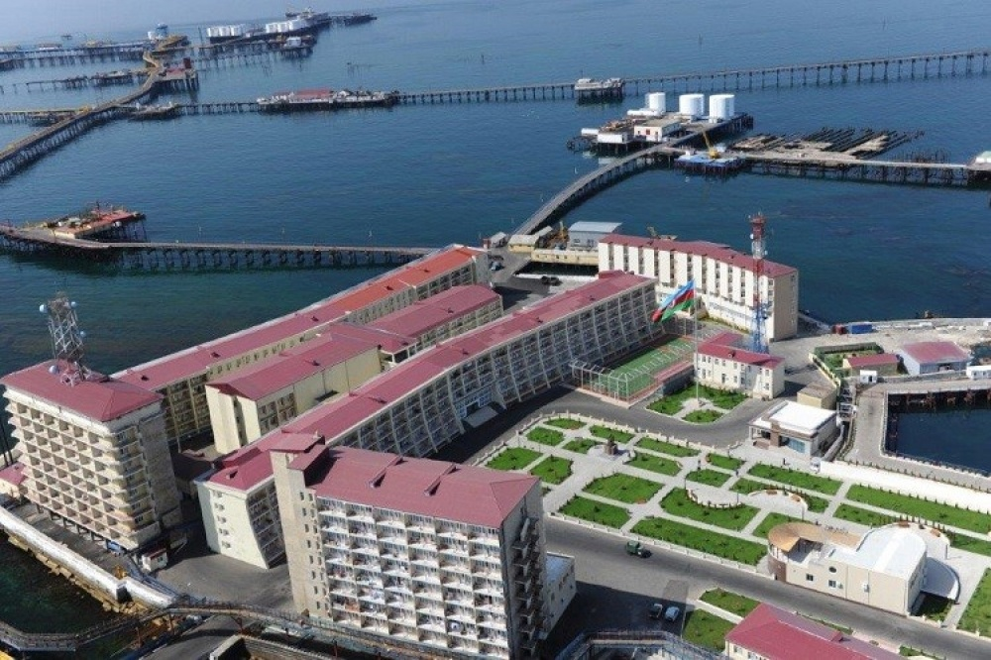
While it once boasted, among other amenities, its own park with trees and soil imported from the mainland, its own soccer pitch, movie theater, library, gardens and more, it is now a shadow of its former glory.
6

Slide 7
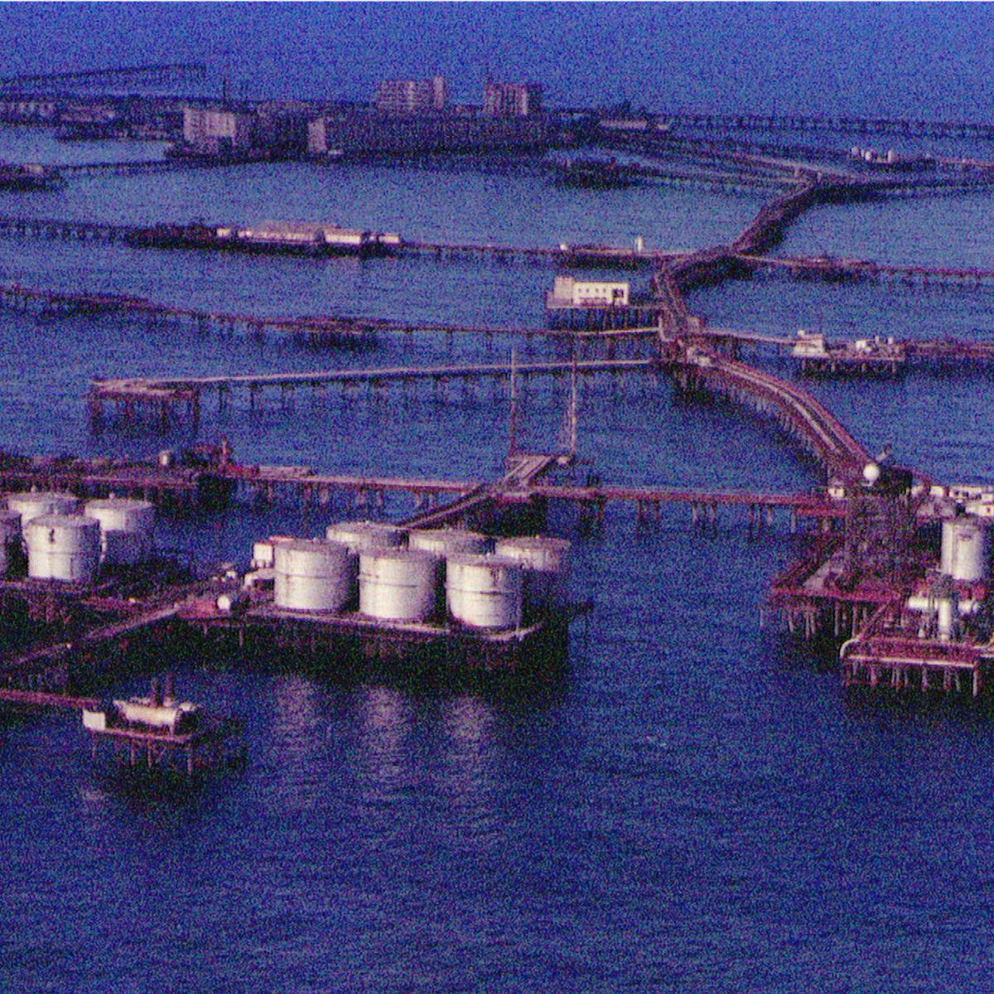
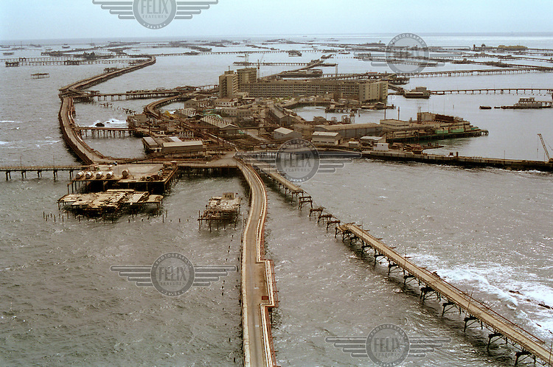
The massive floating city has been ravaged by floods and deterioration of time, and many of the roads and apartments are submerged. Now population of Neft Dashlari is 916. The city itself may not be around for much longer.
7

Slide 8

Coober Pedy
8
8

Slide 9
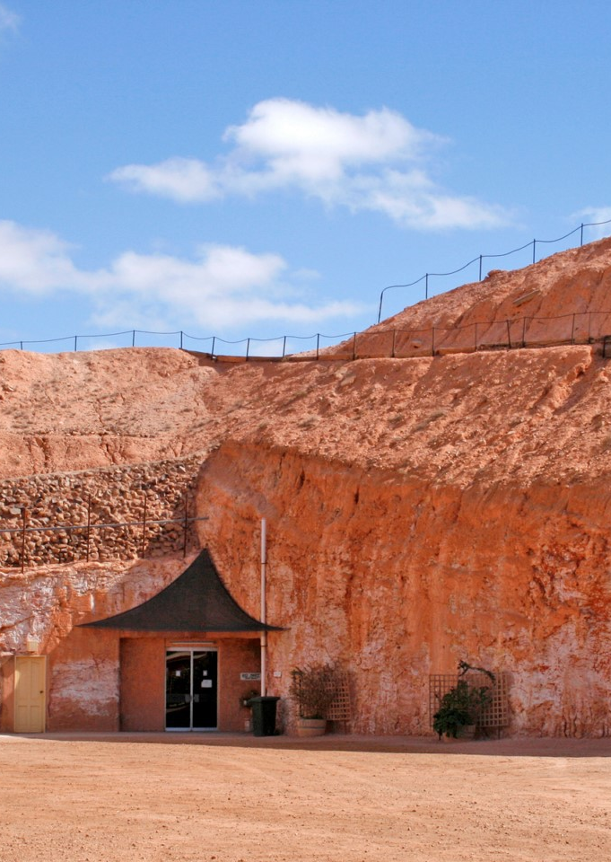
The town in the rock
30% of the world's reserves are concentrated on the territory of Coober Pedy.
Because of the constant heat, drought, and frequent sandstorms, the miners and their families initially settled in houses cut into the mountainside.
9

Slide 10
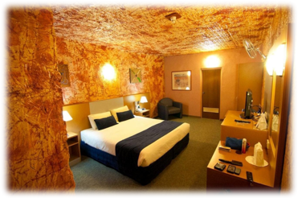
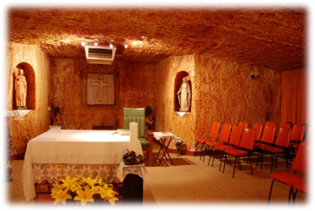
Houses in Coober Pedy
The comfort level was not much inferior to that of traditional "surface" houses: there were bedrooms, living rooms, kitchens and bathrooms.​
10

Slide 11
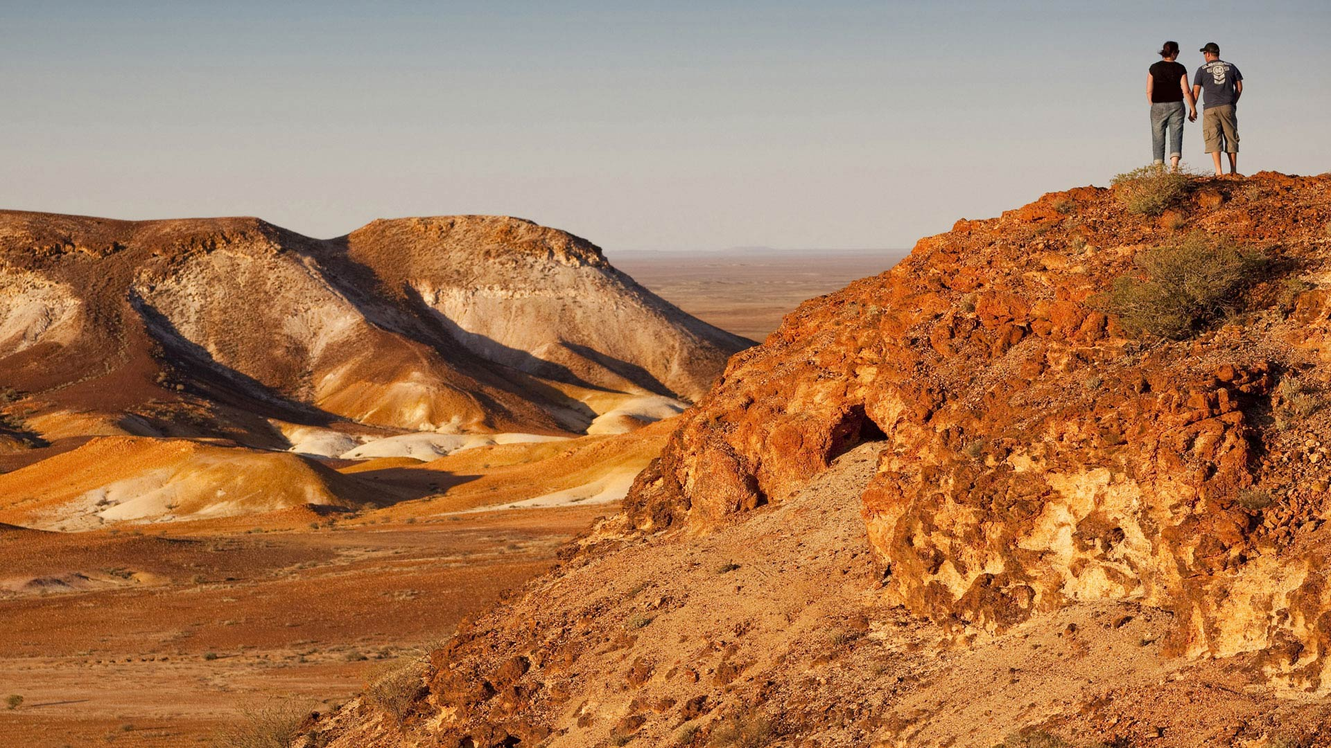
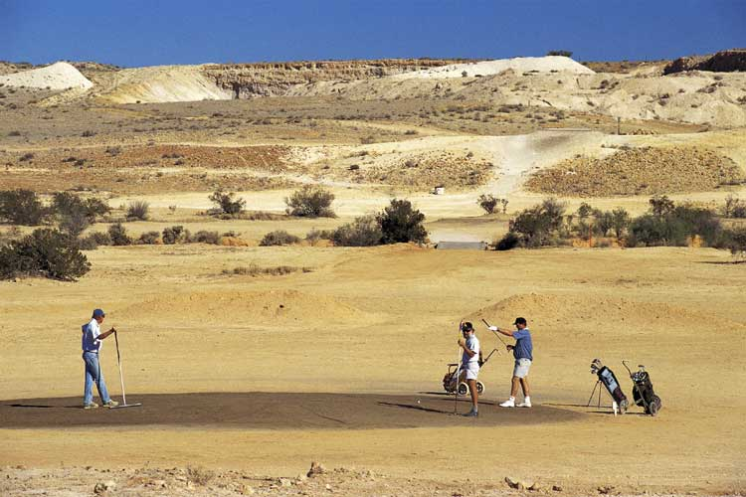
Entertainment in the desert
It's one of the driest and hottest areas in Australia. It almost never rains, so vegetation is sparse.
However, residents don't complain about the lack of outdoor entertainment. They spend their free time playing golf, but because of the heat they often must play at night.
11

Slide 12
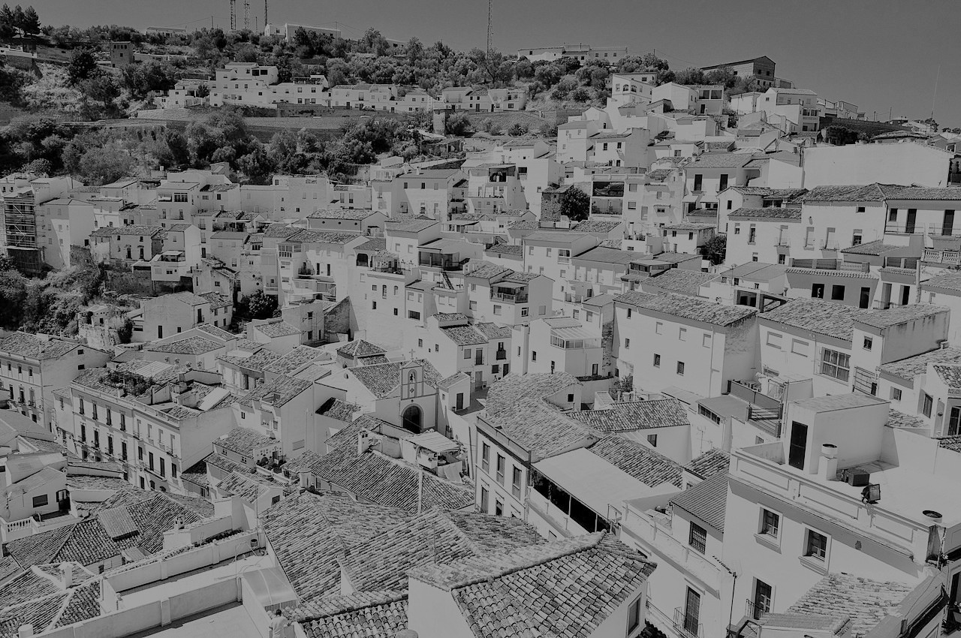
Setenil de las Bodegas
12
12

Slide 13

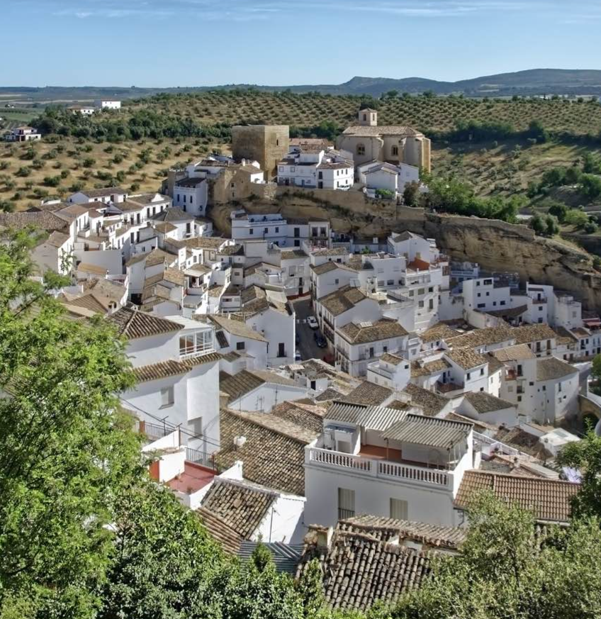

ОБЛАСТИ РОСТА
 | B2B | ЦЕПОЧКА ПОСТАВОК | ROI | ЭЛЕКТРОННАЯ КОММЕРЦИЯ
1-й кв. | 4,5 | 2,3 | 1,7 | 5,0
2-й кв. | 3,2 | 5,1 | 4,4 | 3,0
3-й кв. | 2,1 | 1,7 | 2,5 | 2,8
4-й кв. | 4,5 | 2,2 | 1,7 | 7,0
It is unique in that some of the houses are built into the rock walls, by enlarging natural caves or sheds and adding an outer wall. The main theory is that such a solution helped to escape in times of war.
13
13

Slide 14
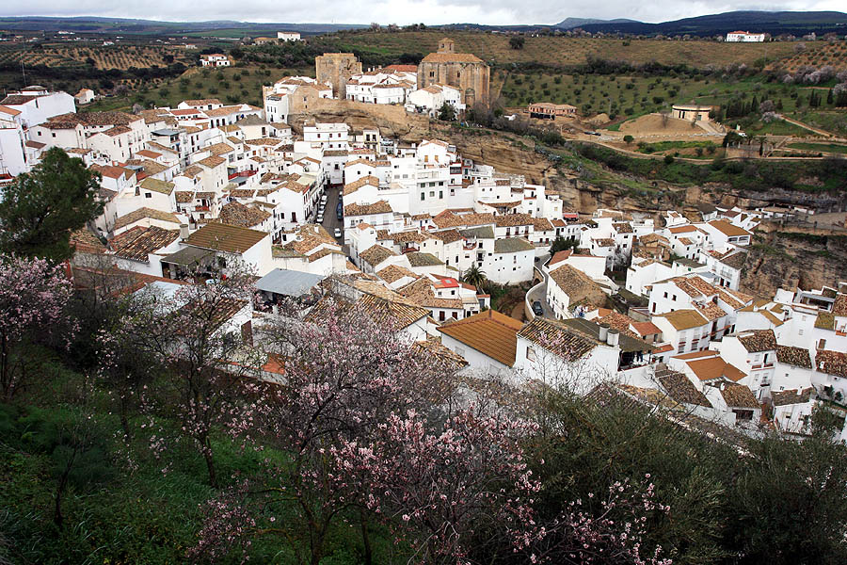
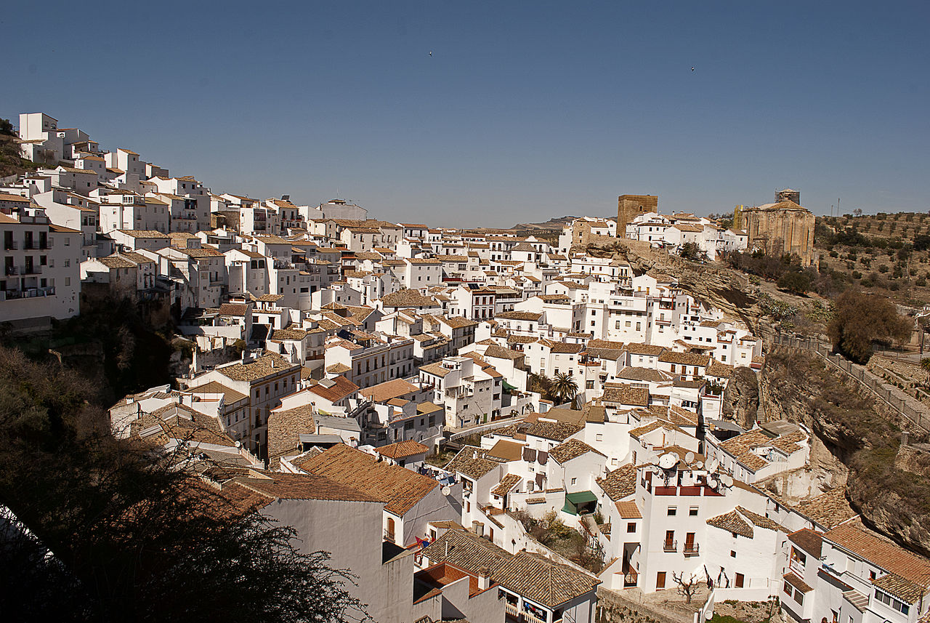
ОБЛАСТИ РОСТА
History of Setenil de las Bodegas
 | B2B | ЦЕПОЧКА ПОСТАВОК | ROI | ЭЛЕКТРОННАЯ КОММЕРЦИЯ
1-й кв. | 4,5 | 2,3 | 1,7 | 5,0
2-й кв. | 3,2 | 5,1 | 4,4 | 3,0
3-й кв. | 2,1 | 1,7 | 2,5 | 2,8
4-й кв. | 4,5 | 2,2 | 1,7 | 7,0
Modern Setenil evolved from a fortified Moorish town that occupied a bluff overlooking the Trejo River. The Castle of Setenil dates back at least to the period of the Almohads in the 12th century.
History tells us that the name of the city comes from the Roman-Latin phrase septem nihil ("seven times nothing").
14
14

Slide 15
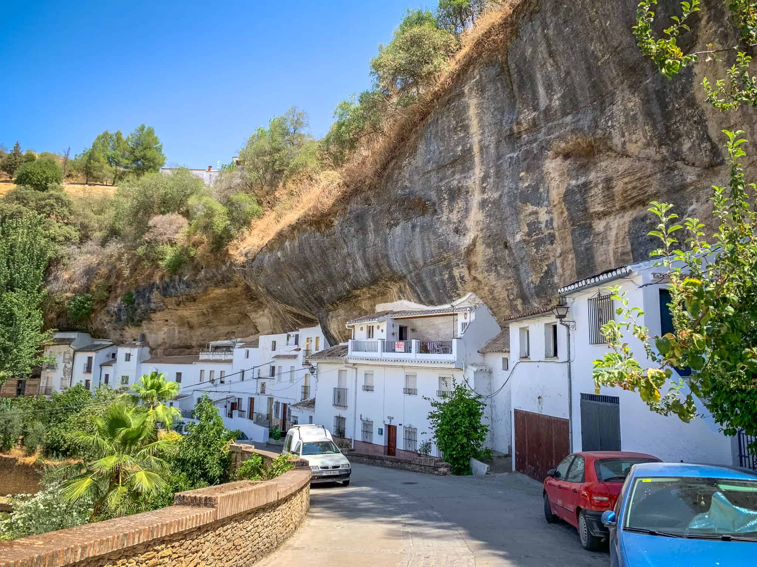
ОБЛАСТИ РОСТА
Nowadays, after overcoming the emigration processes of the second half of the 20th century, Setenil continues to develop according to its traditions. Its urban structure, beauty and uniqueness make it one of the most attractive tourist destinations in the country.
 | B2B | ЦЕПОЧКА ПОСТАВОК | ROI | ЭЛЕКТРОННАЯ КОММЕРЦИЯ
1-й кв. | 4,5 | 2,3 | 1,7 | 5,0
2-й кв. | 3,2 | 5,1 | 4,4 | 3,0
3-й кв. | 2,1 | 1,7 | 2,5 | 2,8
4-й кв. | 4,5 | 2,2 | 1,7 | 7,0
15
15

Slide 16
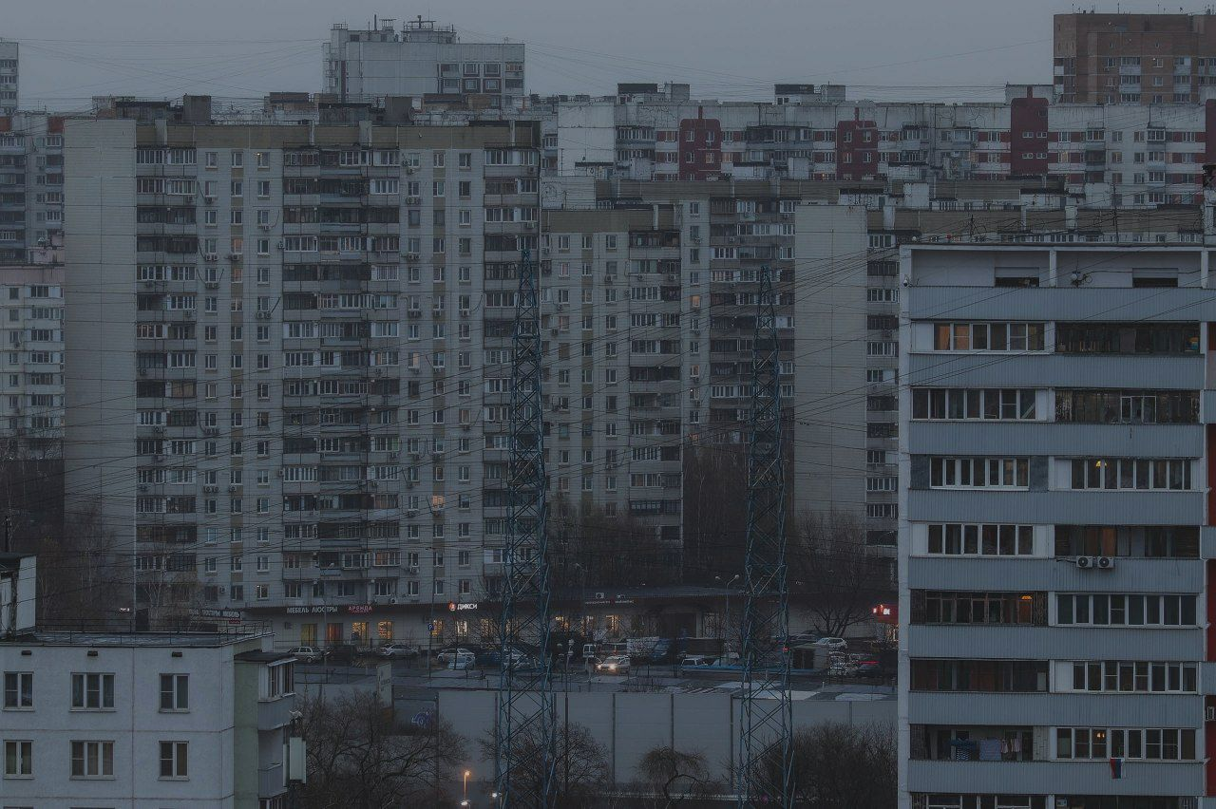
Thanks for your attention
16

